Slide 1

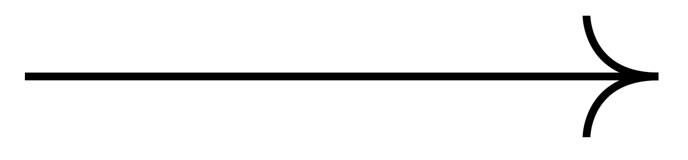
Investigate and Implement KNN Classifier
Software Engineering Course
Lecturer: Damir Dobric / Andreas Pech
2023-2024
Group Name: Global Variable
Group Member: Muhammad Haris (1440274)
Zaka Ahmad (1436851)

Slide 2
Project Goal
KNN Experiment and Unit Test demonstrating how KNN works.
KNN Implementation with SP generated SDR’s.
KNN Implementation with TM generated SDR’s and Unit Test of the experiment.
Replace the HTMClassifier with your KNN Classifier
.

Slide 3
Table of contents
01
02
03
04
KNN Classifier Working Principle
Navigating the principles that form the Classifer of in-depth KNN studies
KNN Parameters and Matrix
Distance matrix, K-Value selection, and Voting
Project Methodology
Following a structured approach to efficiently manage project tasks
Approaches and Challenges
Approaches and challenges face while executing the project

Slide 4
Table of contents
05
06
07
08
Results
Classification of the SDR Class on Output Window
Unit Test
Unit test preform to test the algorithm
Conclusion
Concluding the solution of the problem with results.
References
Research Paper reference used for the project

Slide 5
KNN Classifier Introduction
The K-Nearest Neighbors (KNN) algorithm is a simple yet effective method for classification tasks in machine learning. It is a non-parametric, instance-based learning algorithm, which means it doesn't make strong assumptions about the underlying data distribution and instead relies on the data itself during the prediction phase.
At its core, KNN makes predictions based on the majority class of the K nearest neighbors to a given data point. In other words, it classifies a new instance by finding the K most similar instances in the training data and assigning the most common class label among them to the new instance. However, it's important to note that KNN's performance can be sensitive to the choice of the number of neighbors (K) and the distance metric used to measure similarity between data points.

Slide 6
01
KNN Classifier Working Principle
Navigating the principles that form the Classifier of in-depth KNN studies

Slide 7
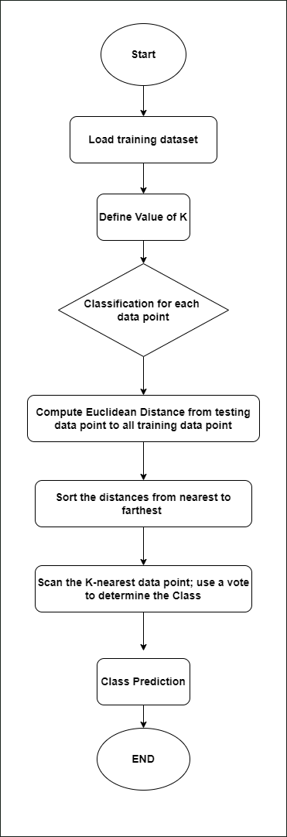
KNN Classifier Working Principle
Loading Dataset
Defining the Value of K
Calculate the distance between the testing data point and all the training data point.
Sort the distances and select the K nearest neighbors.
Assign the class label of test data by majority vote.
Predicting the Class

Slide 8
02
KNN Parameters and Matrix
Distance matrix, K-Value selection, and Voting

Slide 9
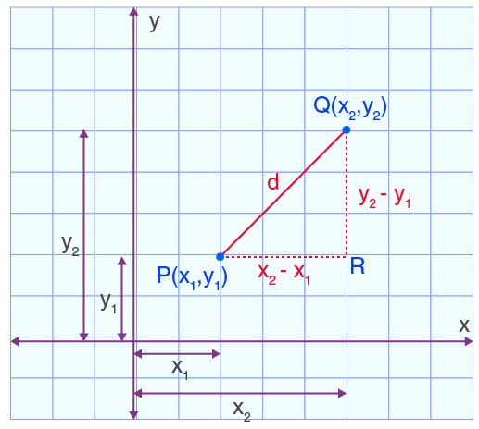
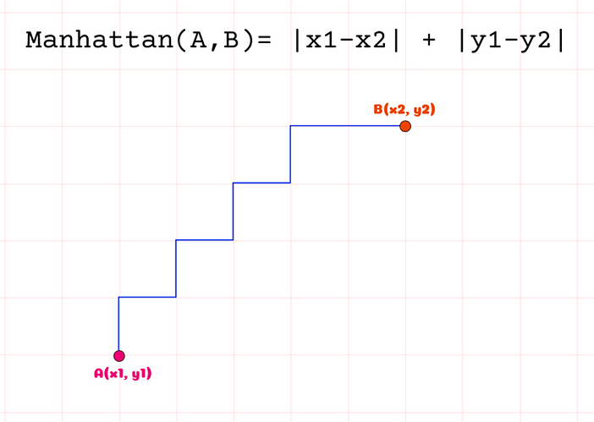
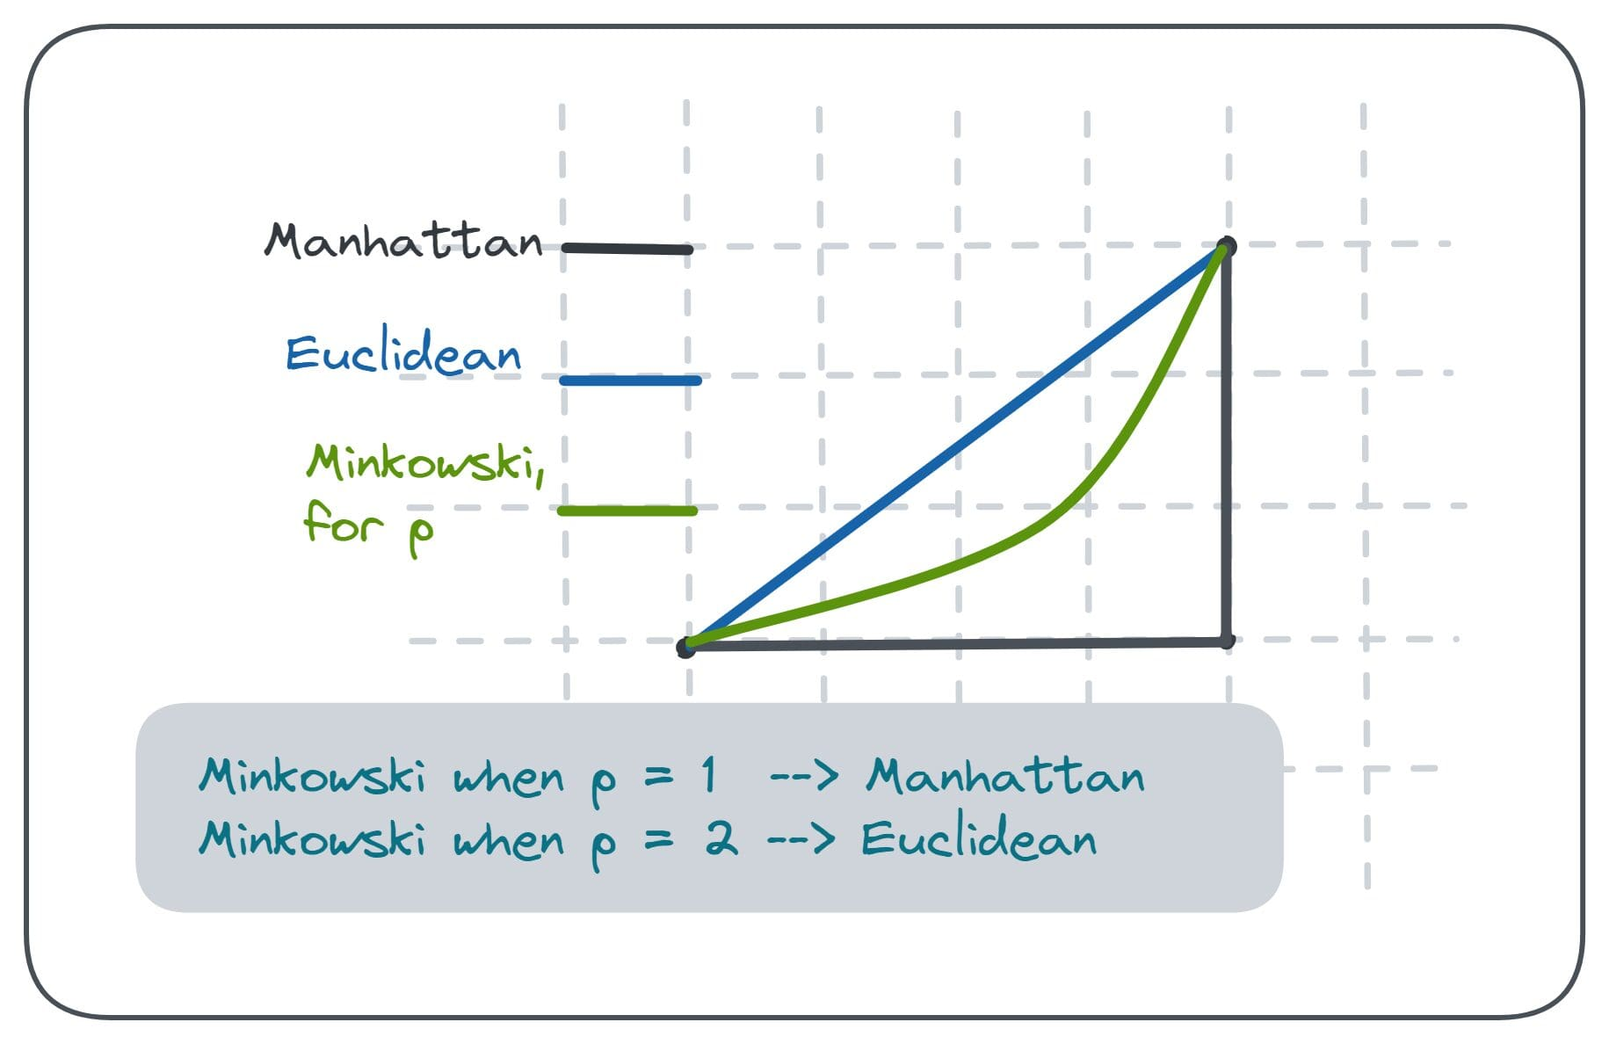
Distance Metrix
Euclidean Distance
Manhattan Distance
Minkowski distance

Slide 10
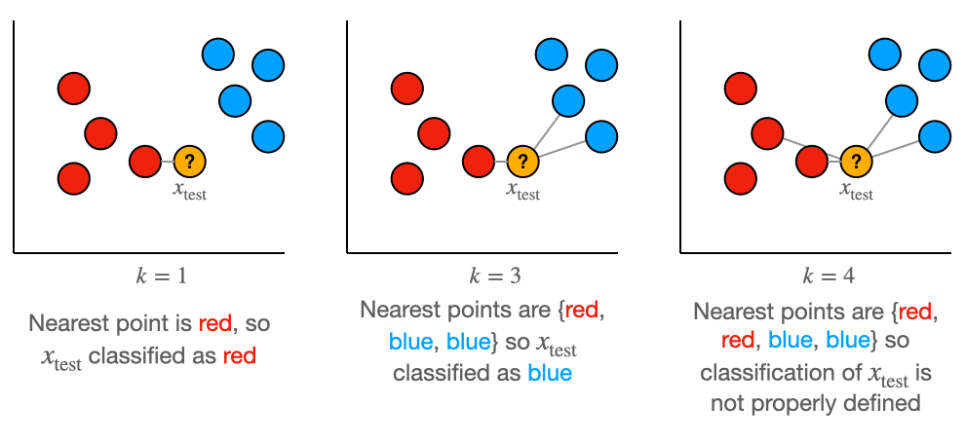
Define the Value of K

Slide 11
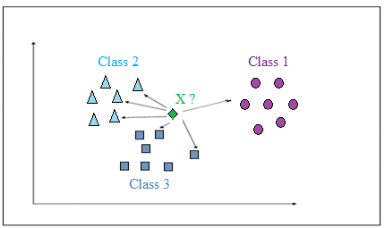
Voting Method
Prediction in KNN is based on K nearest neighbors.
The predicted or Winning class determined by majority voting principle.
Class with highest number of votes assigned to the element.
Important Thing to Consider
Choice of K impacts voting outcome.
Higher K values may lead to less confident predictions.
Imbalanced data scenarios can bias majority voting.
One class outweighing the other can skew predictions.
Techniques to resolve bias in majority voting are Distance-weighted voting and Weighted voting.

Slide 12
03
Project Methodology
Following a structured approach to efficiently manage project tasks

Slide 13
Project WorkFLOW
Encoder
Spartial Pooler
Input Sequence
Temporal Memory
Sparse Distribution Representation
Dataset File
KNN CLassifier
Predicted Input Sequence

Slide 14
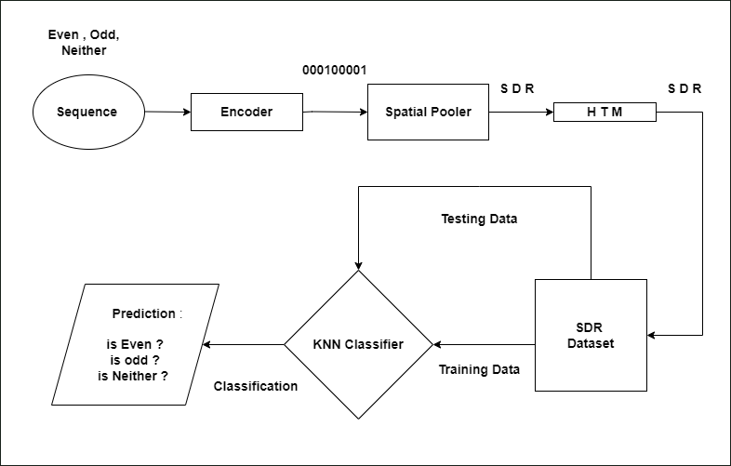
Process Diagram

Slide 15
04
Approaches and Challenges
Approaches and challenges face while executing the project

Slide 16
Approaches and Challenges
1. Classification of numbers from 0 to 9 in a sequence based on Sparse Distributed Representations (SDRs)
Classified data = [
{ 7, 18, 24, 29,……, 1012, 0 };
{ 25, 31, 44, 48,…… ,188, 1 };
{ 118, 123, 127, 156,………, 340, 2 };
{ 240, 242, 257, 266,………., 444, 3 };
{ 302, 314, 324, 327,……., 518, 4 };
{ 393, 405, 428, 429,…….., 624, 5 };
{ 483, 487, 500, 509,………, 726, 6 };
{ 579, 587, 595, 607,…………, 814, 7 };
{ 676, 691, 700, 707,……… , 916, 8 };
{ 772, 779, 780, 800,…………., 1007, 9 };
]
Unclassified data = {461, 495, 515, 501,…, 712 }

Slide 17
Approaches and Challenges
2. Classification of different Sets of Numbers sequences based on Sparse Distributed Representations (SDRs)
[
{
"SequenceName": "S1",
"SequenceData": [8039, 8738, 9334, 9558, 9604, 9697, 9772, 9841, 9851, 9922, 9963, 10023, 10121, 10197, 10373, 10459, 10594, 10629, 10664, 11124]
},
{
"SequenceName": "S2",
"SequenceData": [9051, 9075, 9133, 9178, 9365, 9448, 9481, 9599, 9635, 9740, 10032, 10224, 10281, 10762, 10778, 10934, 11143, 11306, 11494, 11763]
},
{
"SequenceName": "S3",
"SequenceData": [10808, 10834, 11053, 11085, 11434, 11471, 11479, 11553, 11597, 11634, 11720, 11743, 11766, 11812, 11872, 11897, 11909, 12094, 12332, 12504]
}, ...
]

Slide 18
05
Result
Classification of the SDR Class on Output Window

Slide 19
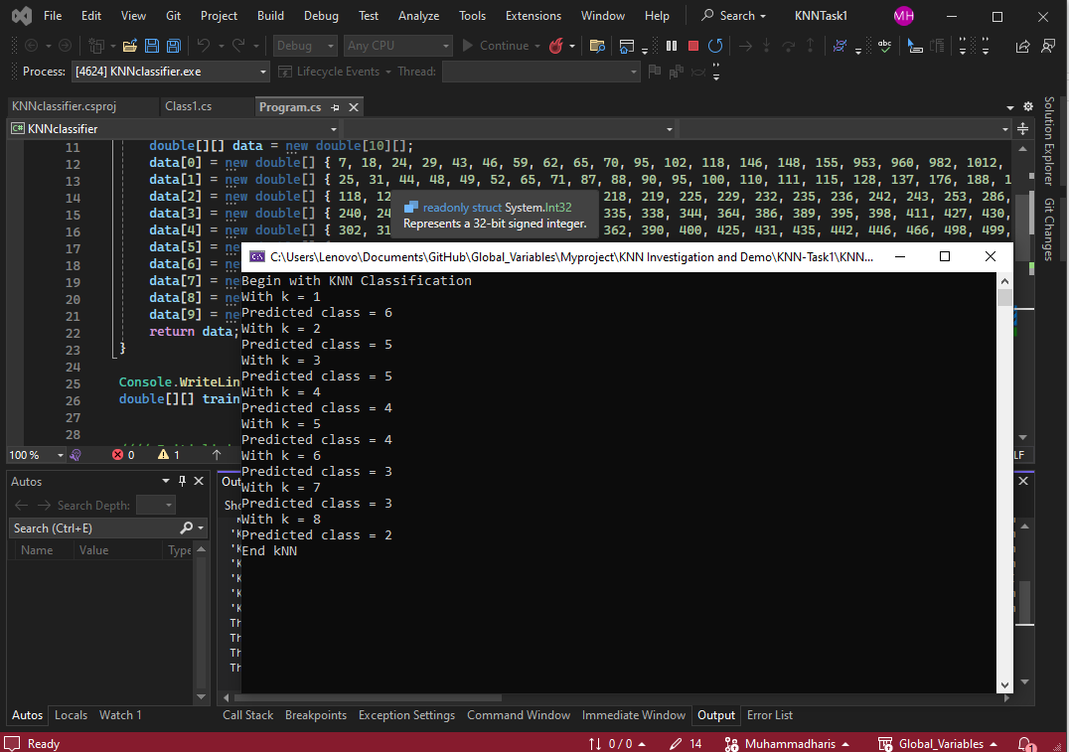
Result
1. Classification of numbers from 0 to 9 in a sequence based on Sparse Distributed Representations (SDRs)

Slide 20
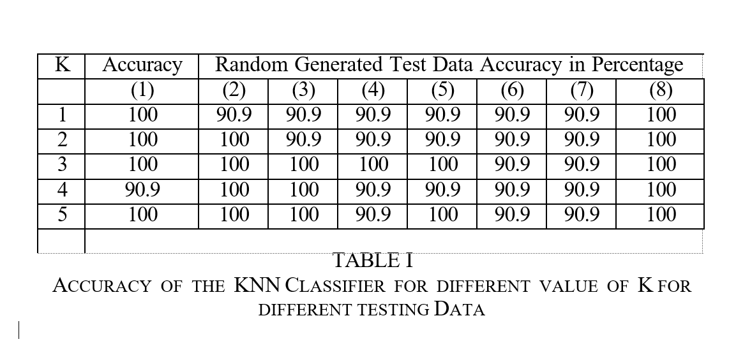
Result
2. Classifying Sets of Numbers based on SDR’s Value

Slide 21
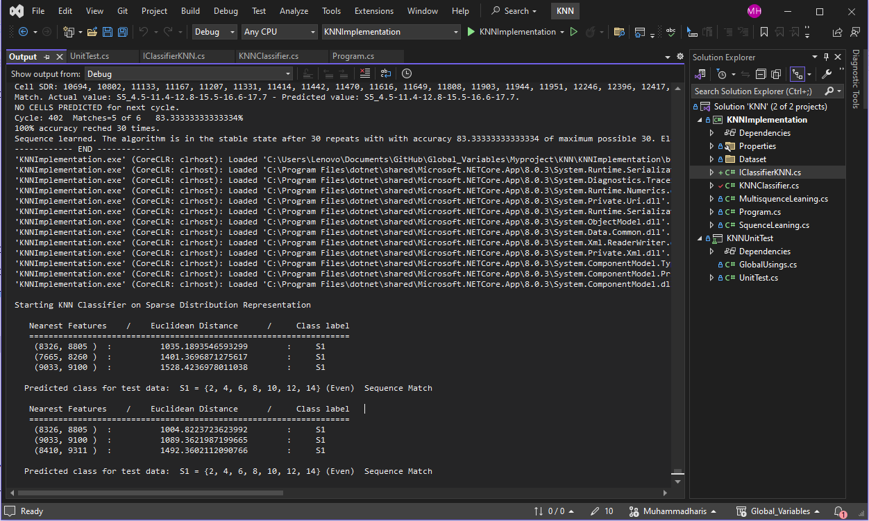
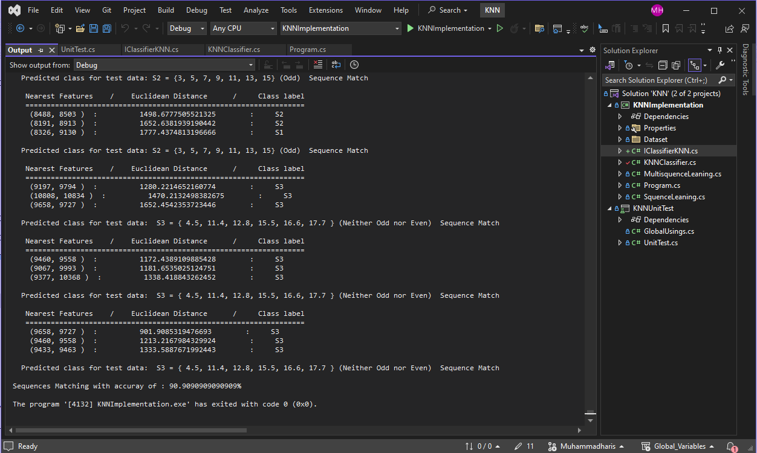
Result
Figure 8 and 9 Output Window presenting the predicted result for test data with accuracy around 90 %.

Slide 22
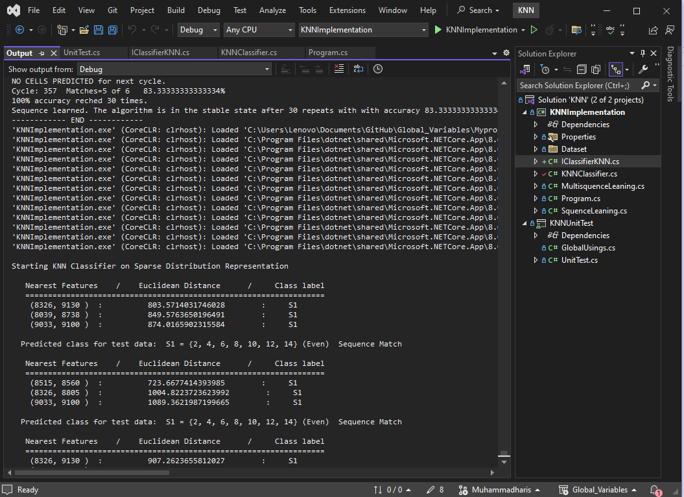
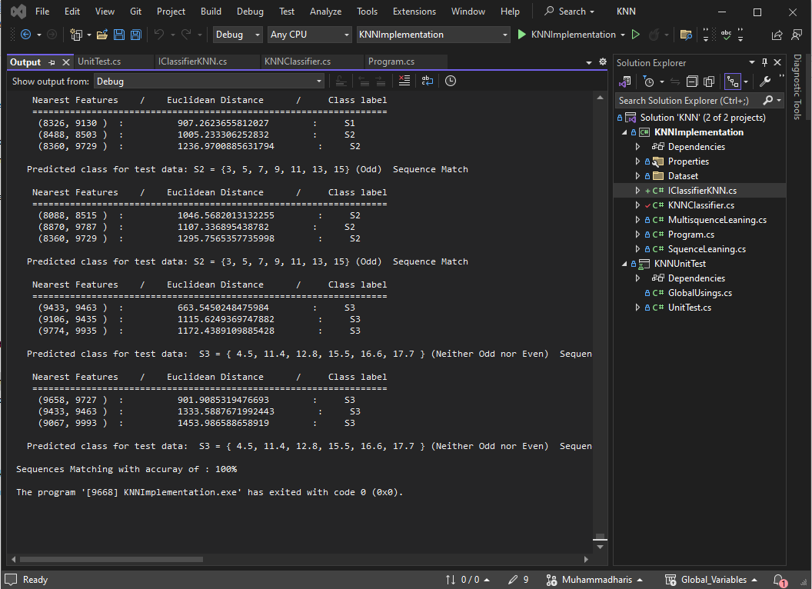
Result
Figure 10 and 11 Output Window presenting the predicted result for test data with accuracy around 100 %.

Slide 23
06
Unit Test
Unit test preform to test the algorithm

Slide 24
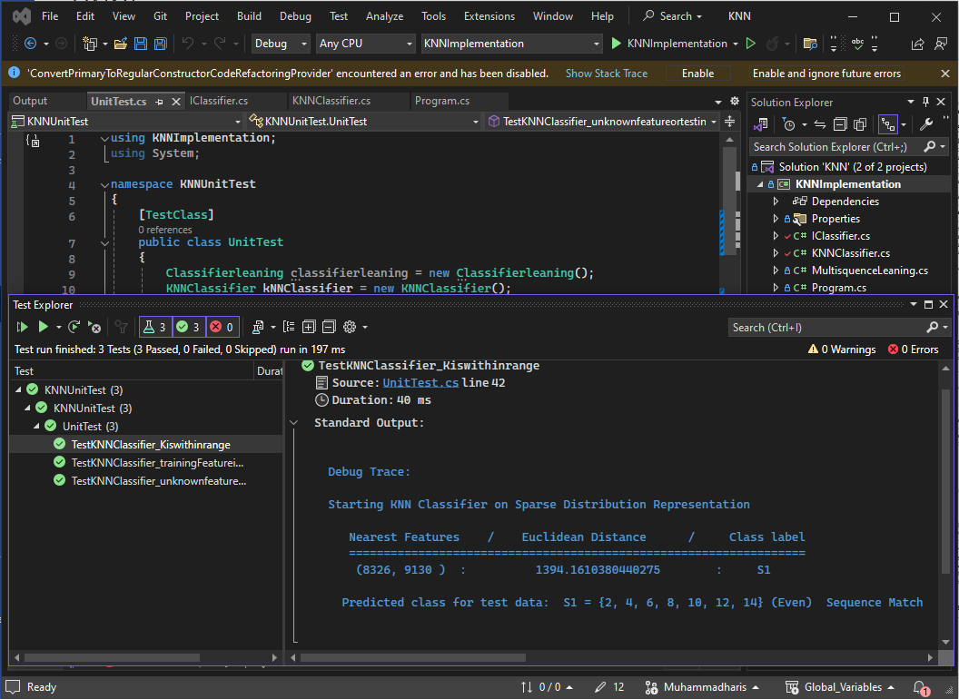
Unit Test

Slide 25
07
Conclusion
Concluding the solution of the problem with results.

Slide 26
Conclusions
KNN Prototype
We initiated the project by designing a generic KNN prototype, achieving the desired outcomes.
KNN integration
we developed the KNN model, seamlessly integrating it with the Neocortex API. The integrated model efficiently processes data streams to predict outcomes, with the KNN classifier accurately classifying sequences as matches or mismatches
Desired Result
our model demonstrates an exceptional accuracy rate of 100% across most input sequences. To ensure robustness, comprehensive unit tests, particularly referencing the HTM Classifier, have been implemented, yielding consistently satisfactory results.

Slide 27
08
Reference
Research Paper reference used for the project

Slide 28
References
[1] N. F. F. E. B. S. L. P. d. L. Marcelo Beckmann, "A KNN Undersampling Approach for Data Balancing," Journal of Intelligent Learning Systems and Applications, vol. Vol.7 No.4, November 11, 2015.
[2] T. &. H. P. Cover, "Nearest neighbor pattern classification.," IEEE transactions on information theory, 13(1), 21-27., 1967.
[3] K. G. K. V. Han EH.., "“Text Categorization Using Weight Adjusted k-Nearest Neighbour Classification”.," In: Cheung D., Williams G.J., Li Q. (eds) Advances in Knowledge Discovery and Data Mining. PAKDD 2001. Lecture Notes in Computer Sci, 2001.
[4] Z. Z., " Introduction to machine learning: k-nearest neighbors.," Ann Transl Med. 2016 Jun;4(11):218., no. doi: 10.21037/atm.2016.03.37. PMID: 27386492; PMCID: PMC4916348..
[5] J. H. D. Z. H. Z. a. C. L. G. Song Yang, " “KNN: Informative knearest neighbour pattern classification,”," Knowledge Discovery in Databases, , p. Pg. 248– 264., 2007.
[6] N. A. M. G. R. M. J. Norsyela Muhammad Noor Mathivanan, "A comparative study on dimensionality reduction between principal component analysis and k-means clustering," Indonesian Journal of Electrical Engineering and Computer Science 16(2):752 , Vols. 10.11591/ijeecs.v16.i2.pp752-758, November 2019. [7]
"Euclidean Distance, https://byjus.com/maths/euclidean-distance/".
[8] L. &. L. C. &. M. N. &. M. A. Liberti, "Euclidean Distance Geometry and Applications," vol. SIAM Review. 56. 10.1137/120875909., 2012.

Slide 29
References
[9] R. &. S. Z. &. Z. E. Suwanda, "Analysis of Euclidean Distance and Manhattan Distance in the K-Means Algorithm for Variations Number of Centroid K. Journal of Physics: Conference Series. 1566. 012058. 10.1088/1742-6596/1566/," 2020.
[10] "How to Decide the Perfect Distance Metric For Your Machine Learning Model,," https://www.turing.com/kb/how-to-decide-perfectdistance- metric-for-machine-learning-model.
[11] B. &. C. M. &. B. C. &. H. P. Lu, "The Minkowski approach for choosing the distance metric in geographically weighted regression.," International Journal of Geographical Information Science. , Vols. 30. 1-18. 10.1080/13658816.20, 2015.
[12] A. &. K. V. &. R. T. Bookstein, "Generalized Hamming Distance.," vol. Information Retrieval. 5. 10.1023/A:1020499411651., 2002.
[13] K. Bala Priya C, "Distance Metrics: Euclidean, Manhattan, Minkowski,," https://www.kdnuggets.com/2023/03/distance-metricseuclidean-manhattan-minkowski-oh.html.
[14] "What is the k-nearest neighbors (KNN) algorithm?," https://www.ibm.com/topics/knn.
[15] J. R. S. H. G. S. R. Goldberger, "Neighbourhood components analysis.," NIPS (2004).
[16] Y. J. D. &. C. D. Cai, "A KNN Research Paper Classification Method Based on Shared Nearest Neighbor.," NTCIR Conference on Evaluation of Information Access Technologies., 2010.
……..
.

Slide 30
Thank You!

